Slide 1

Causal Reasoning for Algorithmic Fairness
Joshua R Loftus, Chris Russell, Matt J. Kusner and Ricardo Silva
Presentation by: Shubham Sharma and Jie Hua

Slide 2



GOAL
A fair classifier gives the same prediction had the person had a different value of the protected attribute
Non-causal fairness algorithms do not consider underlying problems that may cause a model to be unfair
Our goal is to introduce the idea of using causal models for algorithmic fairness and provide an intuition into why this is crucial

Slide 3

EXAMPLE: APPLYING TO LAW SCHOOL

Slide 4
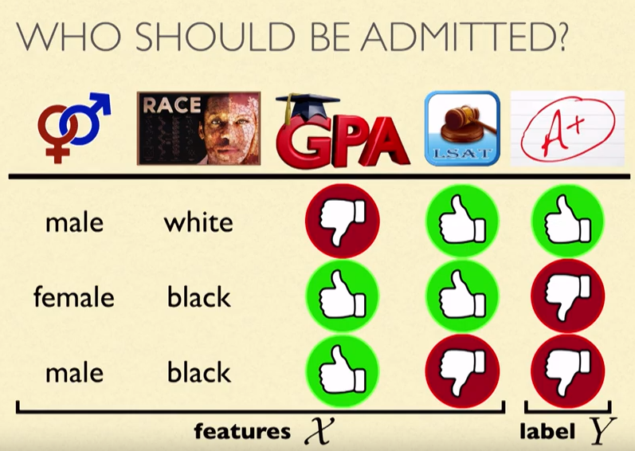

Slide 5
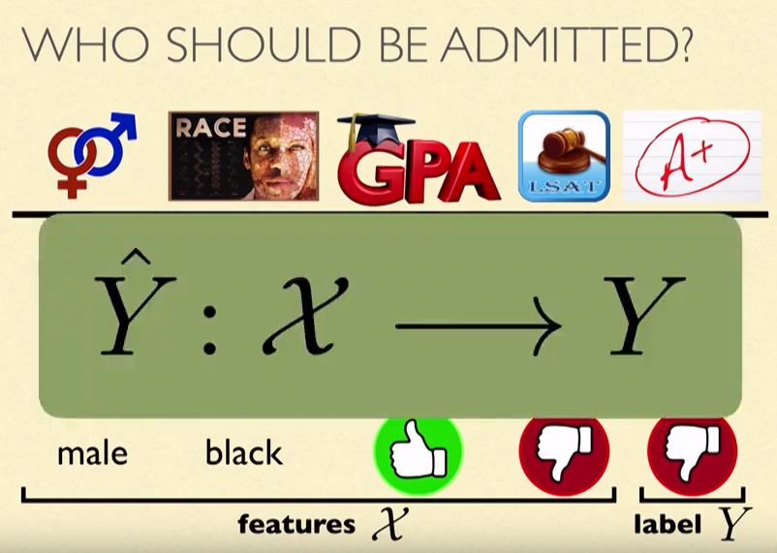

Slide 6
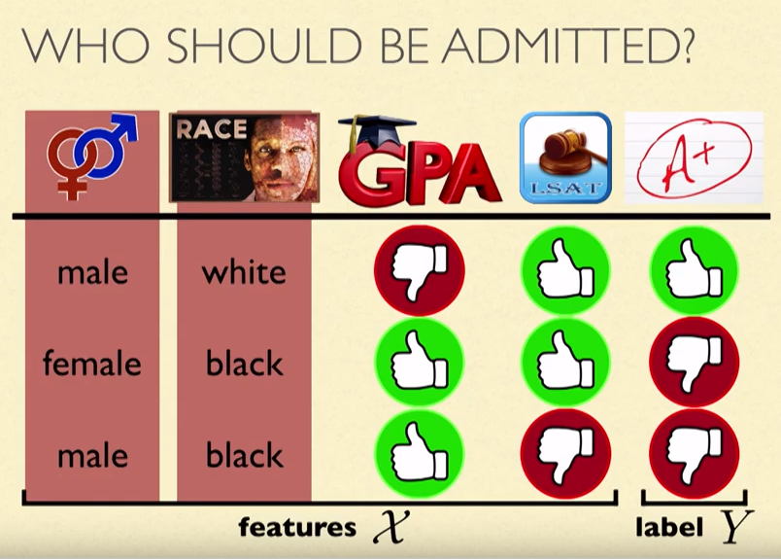

Slide 7

HOW DO WE ENSURE THAT THE CLASSIFIER IS FAIR?
Let’s review existing methods:
Fairness through unawareness
Equalized odds
Demographic parity

Slide 8
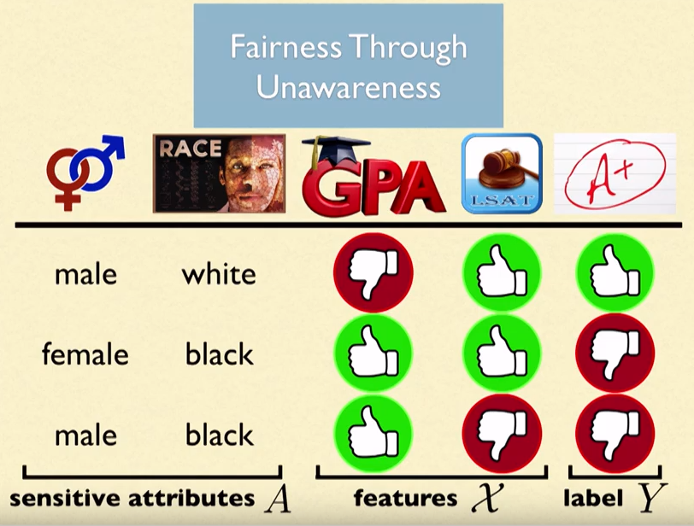

Slide 9
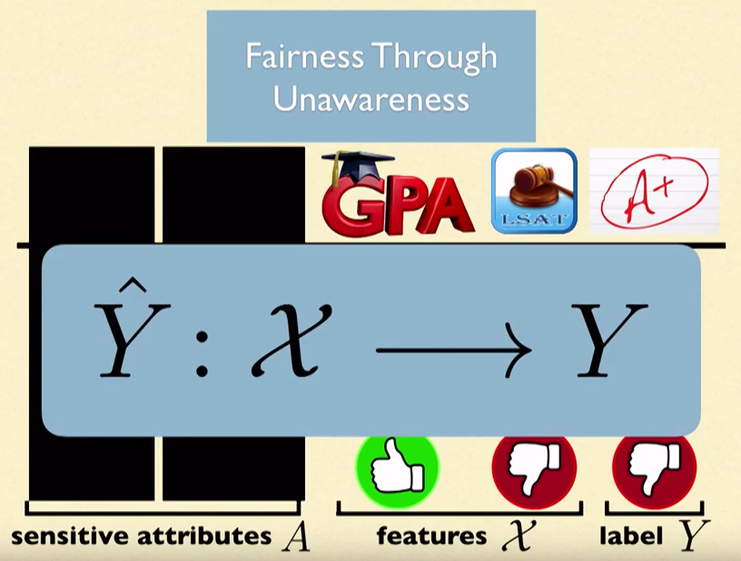

Slide 10
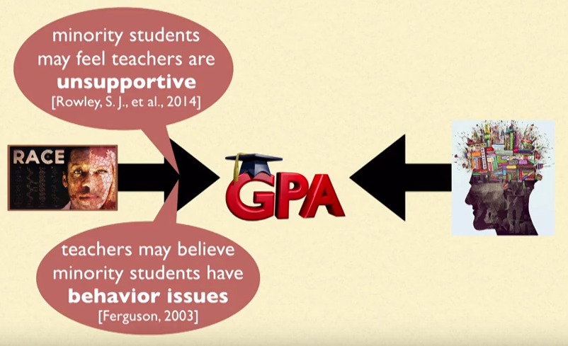

Slide 11
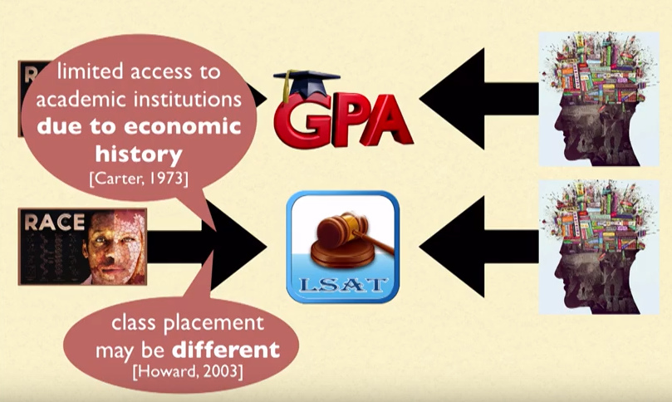

Slide 12
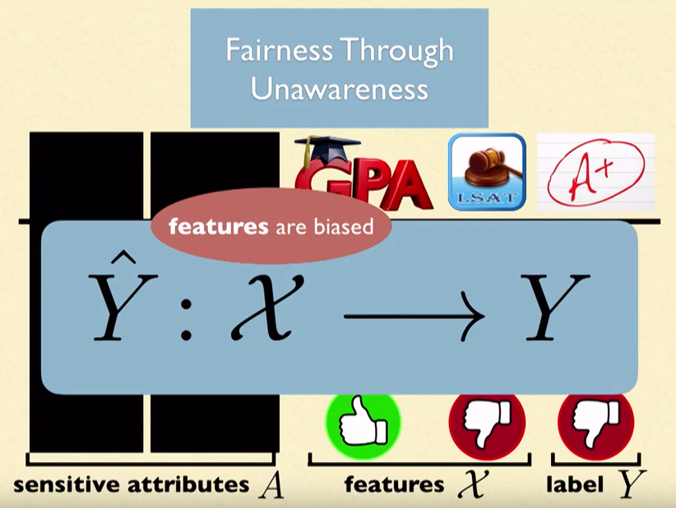

Slide 13
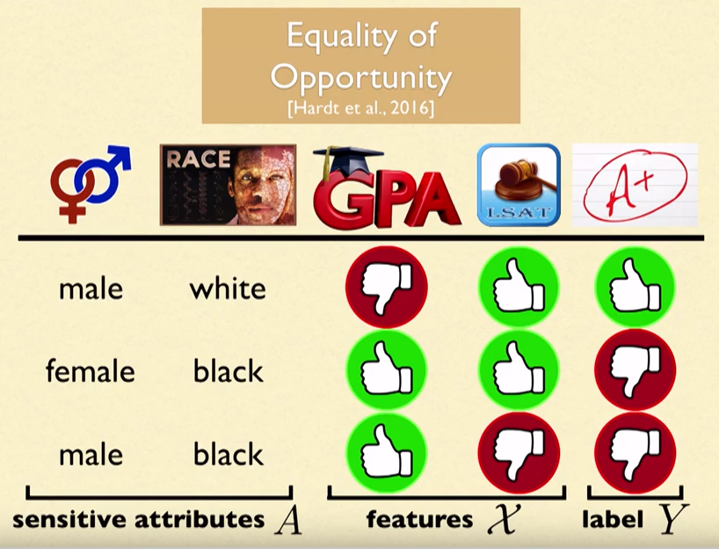

Slide 14
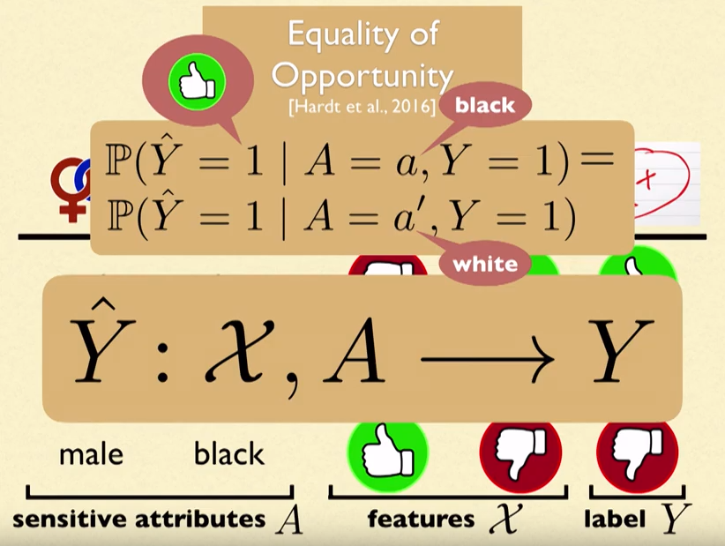

Slide 15
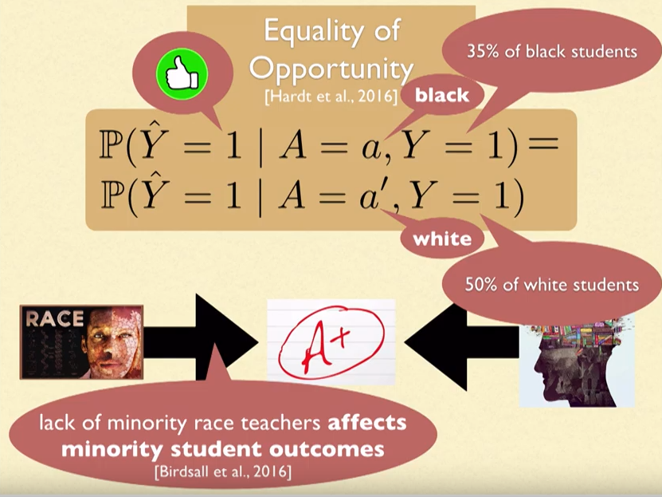

Slide 16
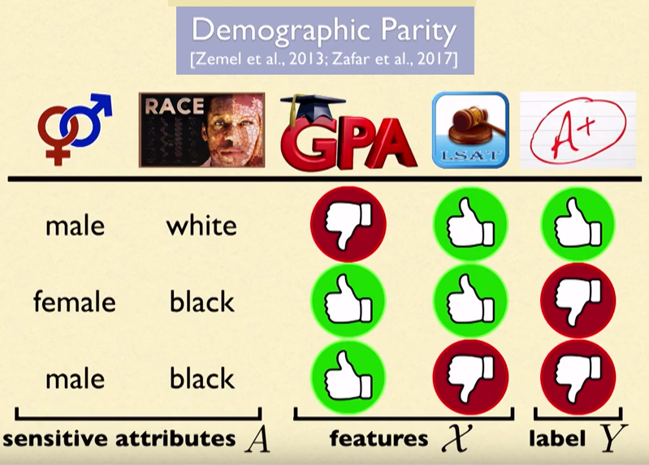

Slide 17
If a protected attribute category with less qualified individuals is present, that category would still be getting a positive prediction at the same rate as another category.

Slide 18
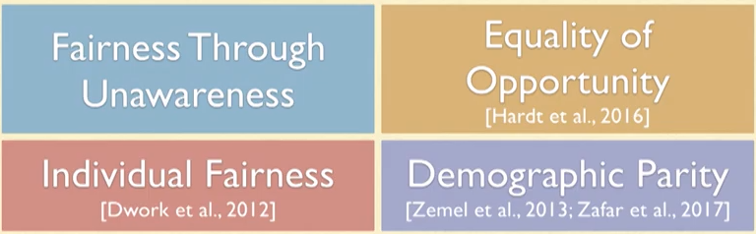
Existing methods
Any fairness notion based on observation alone will suffer similar problems, because they cannot model how discrimination happens

Slide 19
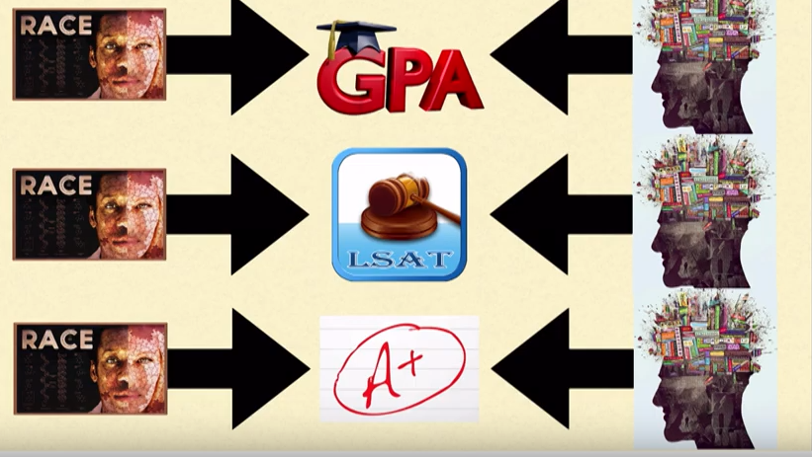
CAUSALITY

Slide 20
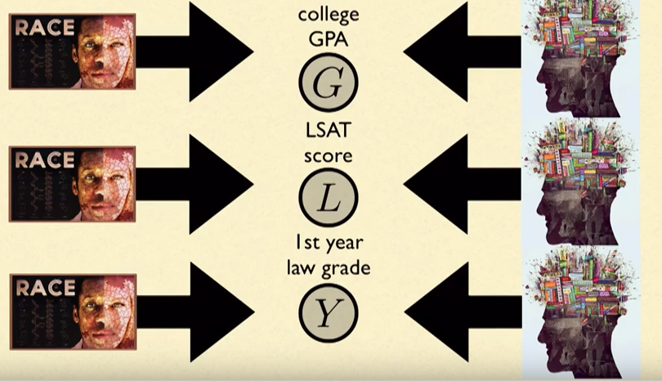
CAUSALITY

Slide 21
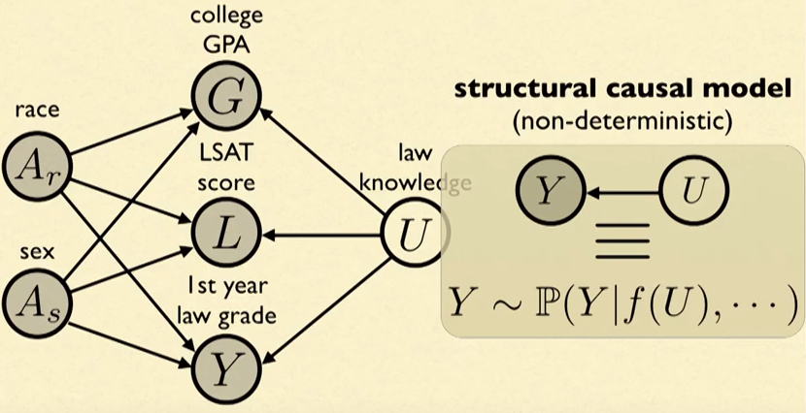
CAUSAL MODELS

Slide 22
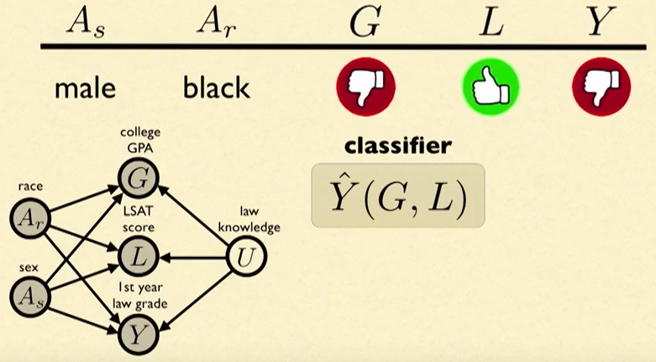
HOW DO WE USE SUCH A MODEL?
The notion of counterfactuals: What would the classifier have predicted had the individual protected attribute change?

Slide 23
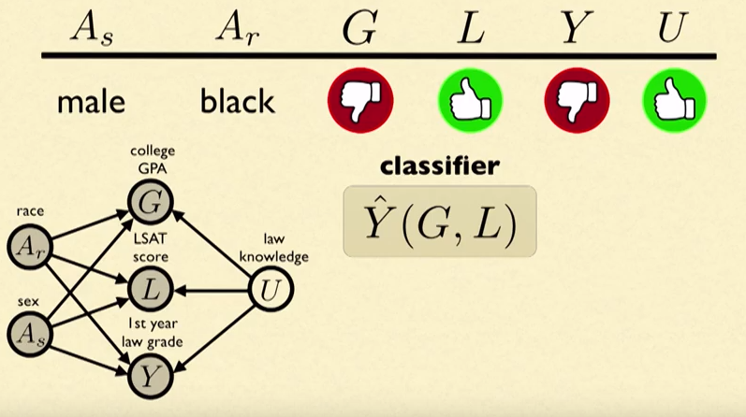

Slide 24
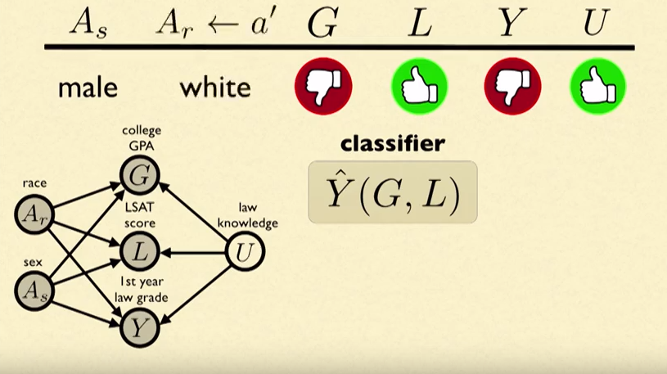

Slide 25
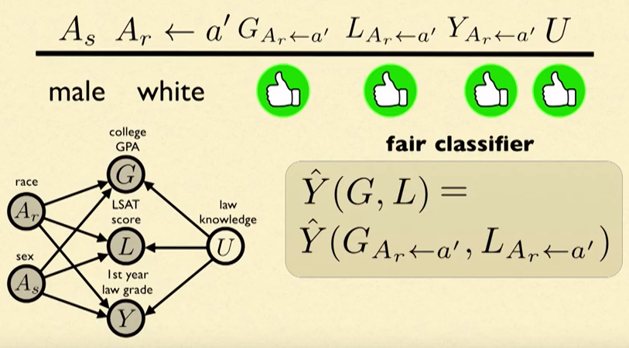

Slide 26
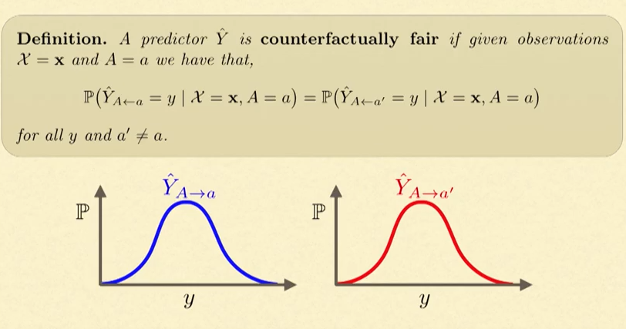
COUNTERFACTUAL FAIRNESS

Slide 27
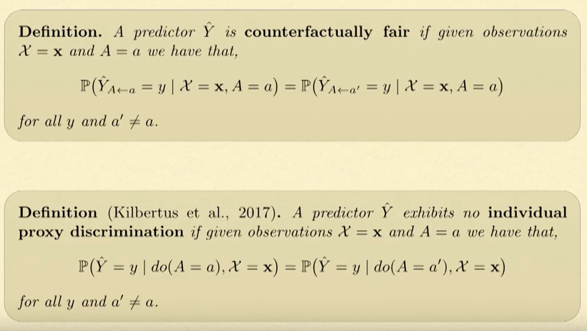

Slide 28
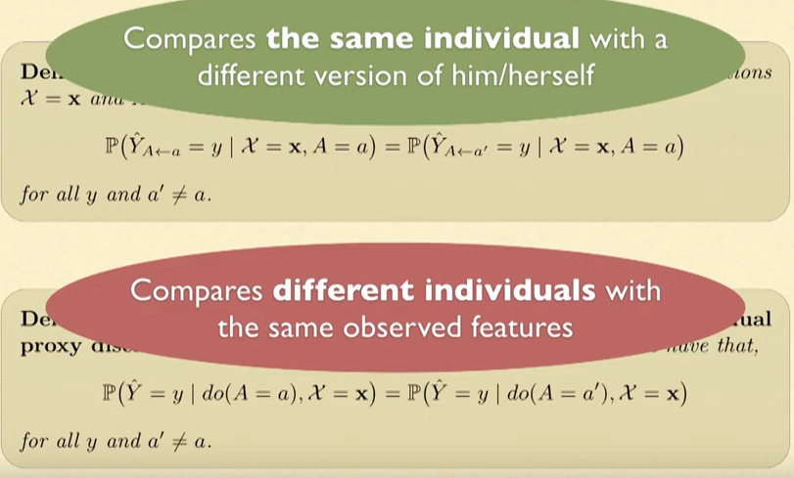

Slide 29
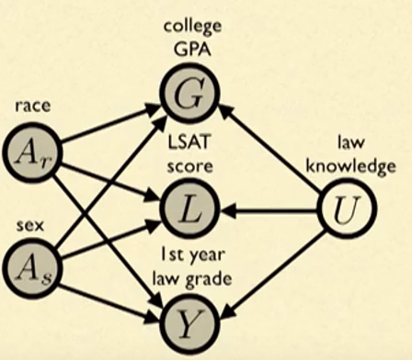
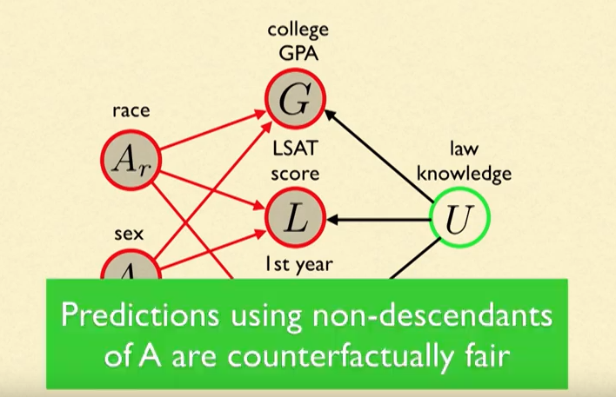
HOW DO WE MAKE COUNTERFACTUALLY FAIR CLASSIFIERS?

Slide 30
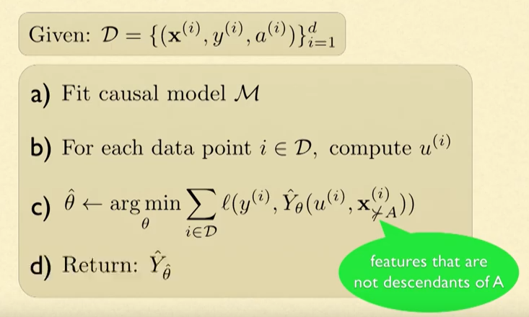

Slide 31
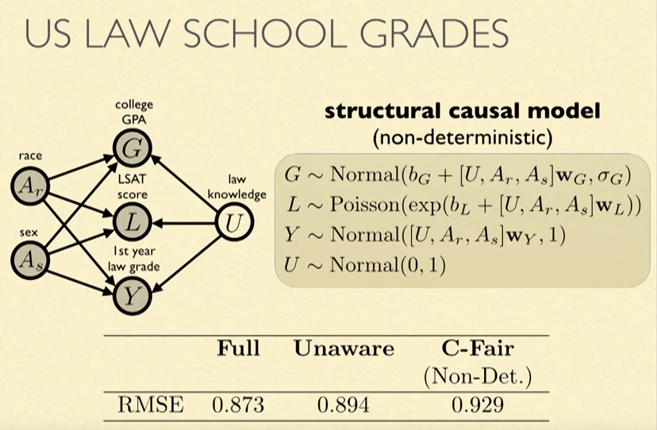
Counterfactually fair model in practice

Slide 32
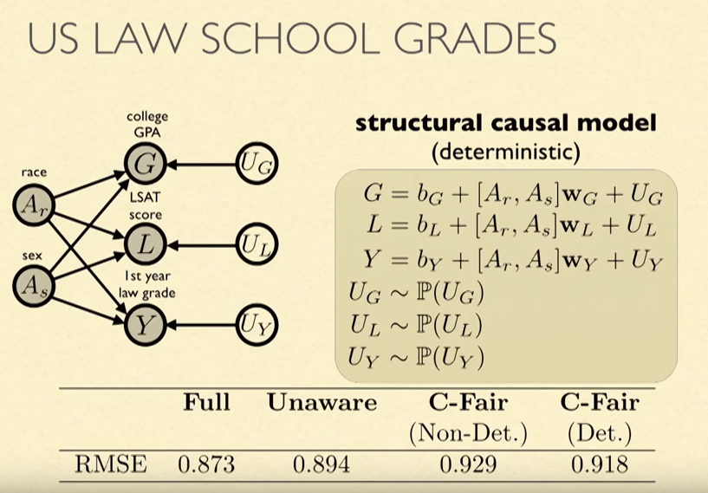
Counterfactually fair model in practice

Slide 33
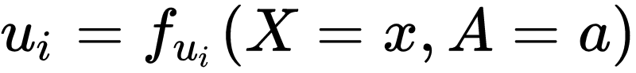
Relationship with Common Statistic Notions.
Relationship with Common Statistic Notions.
-Demographic parity
Notes:
This paper also discussed the relationship of counterfactual fairness and other fairness notions. We can achieve other kind of fairness using the counterfactual fairness algorithm in this paper with some modifications. First is the demographic parity, If Y is a function only of background variables and observed variables which are independent to A and U is uniquely determined by X and A.
As you can see, this equation is the counterfactual fairness constraint.

Slide 34
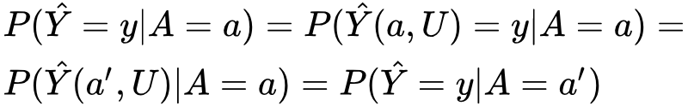
Relationship with Common Statistic Notions.
Relationship with Common Statistic Notions.
-Demographic parity

Slide 35
Relationship with Common Statistic Notions.
-Individual Fairness
Notes:
The second one is individual fairness. This equation in the first line is the individual fairness constraint. In another paper, they actually proposed a matching function to use to map this constraint to the counterfactual framework. But here I will only give you an intuition of the idea.

Slide 36
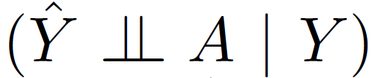
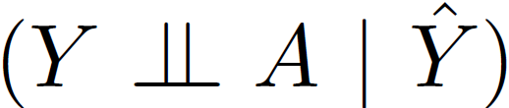
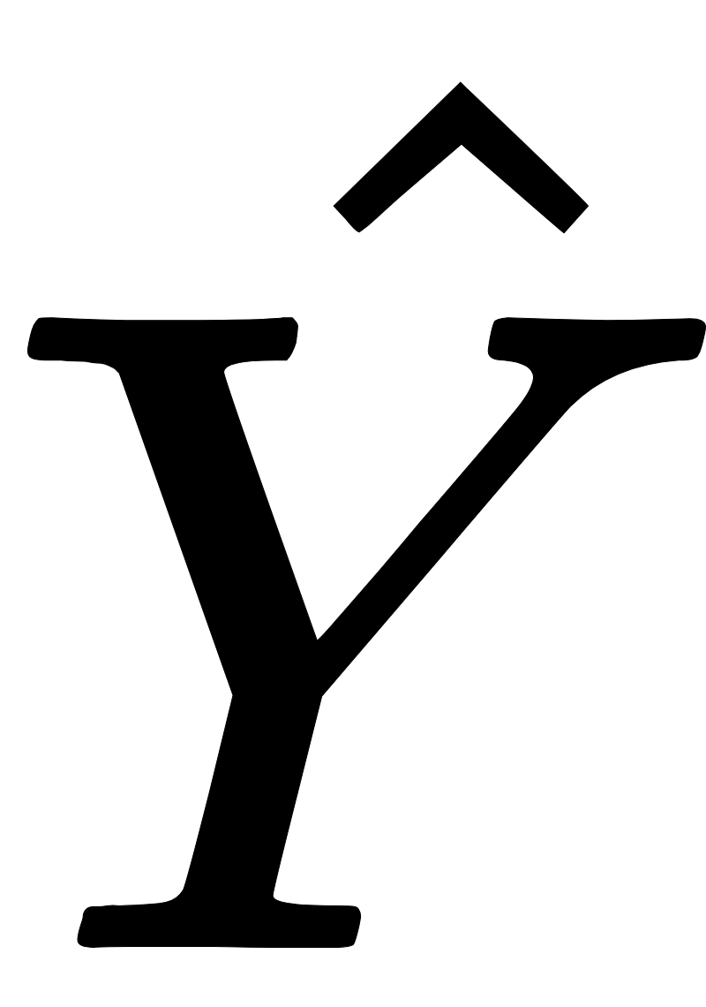
Relationship with Common Statistic Notions.
-Equalised Odds and Calibration
If a counterfactually fair is built by just using non-descendants of A in the graph, it will respect both equalised odds and calibration.
Notes:
The last one is the equalised odds and calibration.

Slide 37
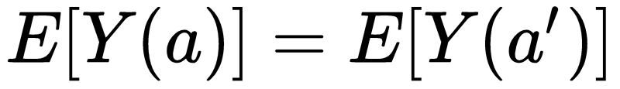
Parallel Work in Causality Fairness
How to achieve counterfactual fairness without explicit structural equations?
Enforcing [1]. But require throwing away all information from any descendant of A that is on an “unfair path”.
Decomposing the cause effects across different path [2].
A
X
C
A
Y
[1] R. Nabi and I. Shpitser. Fair inference on outcomes. 32nd AAAI Conference on Articial Intelligence, 2018.
[2] J. Zhang and E. Bareinboim. Fairness in decision-making: the causal explanation formula. 32nd AAAI conference on Articial Intelligence, 2018.
Notes:
The actual goal behind this question is to minimise the number of untestable assumptions.
The first solution is to enforce the expectation of Y to the same as respect to a protected variable A. But this comes with a high price. Because we would have to throw away any information…
The second solution is to decompose the counterfactual measures of cause effects across different path. Like on the left, the cause of A on Y can be decomposed to the red path and the blue path. This method although does not provide a way of building fair predictor, it discusses another important topic, how modifications to a particular part of the causal model can affect the counterfactual measures. This helps to explain why and how discrimination is introduced.
One interesting thing is that, in this paper. The graph on the right was argued to be unfair which is different from the paper we have. Our paper says that if in this case Y is unfair then X must be considered another protected variable

Slide 38
Parallel Work -- Path-Specific Effects
Berkeley Admission example.
(A) Gender
(X2) Free-will choice
A
X2
Notes:
I will use the berkeley admission example to explain this. In the admission process of berkeley in the 1970s, a discrimination against female was identified in the admission result. But the actual cause of the discrimination is that women tend to choose the department that are more crowded and less well funded. So fewer women were accepted. Therefore, the admission result was considered fair because the disparity comes from free-will. However it is related to the protected variable.

Slide 39
Parallel Work -- Path-Specific Effects
Berkeley Admission example.
(A) Gender
(X1) Protected Variable
(X2) Free-will choice
A
X1
X2
Notes:
But what if it becomes more complicated. What if we have another feature like funding which could be biased based on gender. What if there are edges from A to X1 and A to Y and even X2 to X1. How can we then analyze the counterfactual measures for the predictor. This paper proposed a path-specific solution to this problem. In the path specific scenario, the protected path which are red and the unprotected path which are blue are treated differently. We forbid unfair contribution of A like through X1 and directed path. And allow fair contribution like through X2.

Slide 40
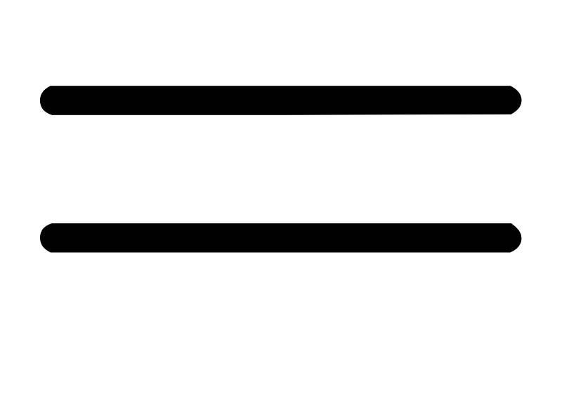
Parallel Work -- Path-Specific Effects
Berkeley Admission example.
(A) Gender
(X1) Protected Variable
(X2) Free-will choice
A
X1
X2
Notes:
More formally, we can use this constraint.

Slide 41
Conclusion
Counterfactual fairness is a new and formal definition of fairness based on causal reasoning.
Existing fairness notions can be discussed and achieved using counterfactual fairness framework.
Counterfactual fairness requires untestable assumptions and domain knowledge to build the causal model.

Slide 42
Additional references
Kusner, M. J., Loftus, J., Russell, C., & Silva, R. (2017). Counterfactual fairness. In Advances in Neural Information Processing Systems (pp. 4066-4076).
Chiappa, S., & Gillam, T. P. (2018). Path-specific counterfactual fairness. arXiv preprint arXiv:1802.08139.
Zhang, J., & Bareinboim, E. (2018, April). Fairness in decision-making—the causal explanation formula. In Thirty-Second AAAI Conference on Artificial Intelligence.

